Slide 1


NHS Data Analysis
Approach, Analysis, Results, and Conclusions
By:
Tuhina Srivastava

Slide 2


Problem Statement
The NHS must expand its infrastructure and resources to meet the growing demand driven by an increasing population.
Accurate budget allotment and resource planning are essential, requiring a thorough understanding of service utilisation trends.
Stakeholders are divided on whether current NHS capacity is sufficient or needs expansion, and whether existing infrastructure could be optimised to improve efficiency.
Additionally, the NHS incurs significant costs due to missed appointments, which need to be understood and minimised.

Slide 3

Objectives
Resource Utilisation Analysis
Missed Appointment Analysis
Temporal Trends Analysis
Public Sentiment Analysis
Additional Questions (distribution and trends)

Slide 4

Data Cleaning
Actual Duration:
Replaced missing values with 'Unknown'
Converted date columns to datetime format
Appointments Regional:
Removed duplicate records
Handled missing values by using appropriate imputation techniques
Converted categorical columns to appropriate data types
National Categories:
Standardised category names for consistency
Handled missing values by filling with the most frequent category
Tweets:
Removed special characters and URLs
Handled missing values by removing empty tweets
Applied text cleaning for sentiment analysis (e.g., lowercase conversion, stopword removal)

Slide 5
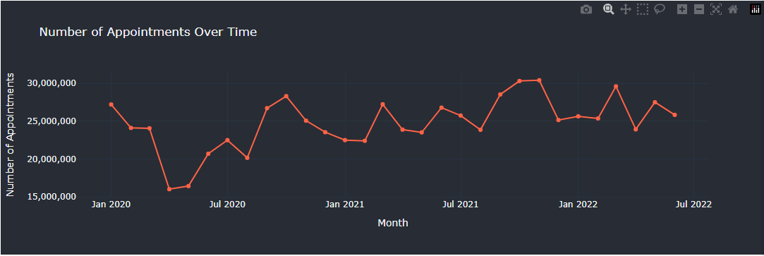

Temporal Trends Analysis
The analysis aimed to identify trends in healthcare resource utilisation over time.
Monthly and Seasonal Trends: This analysis showed that winter months generally had higher appointment volumes, likely due to seasonal illnesses.
Insight: Identifying these trends helps in adjusting resource allocation and staffing levels to meet peak demands effectively.

Slide 6
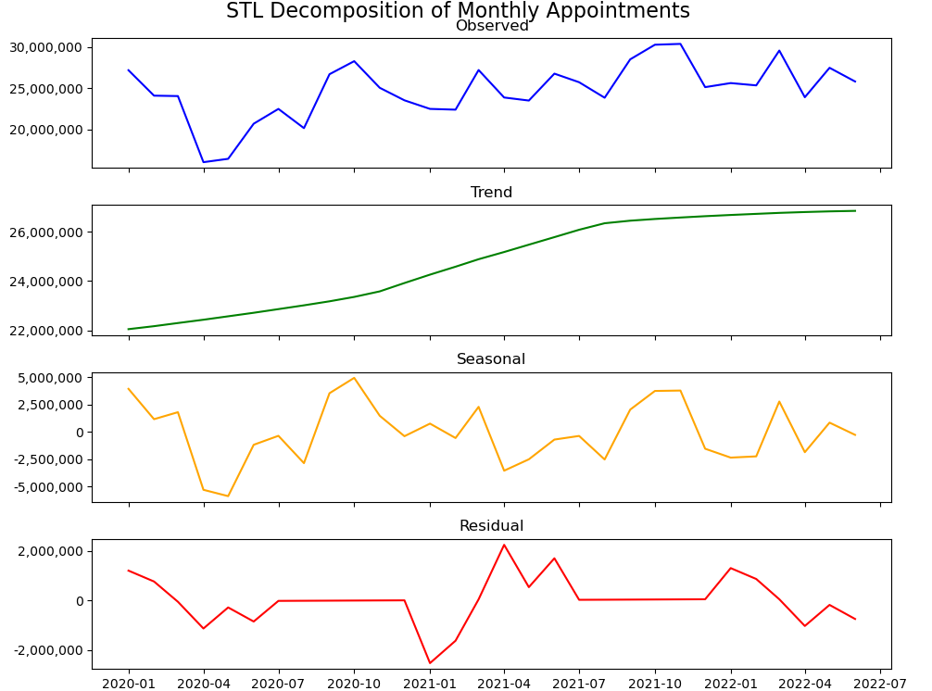
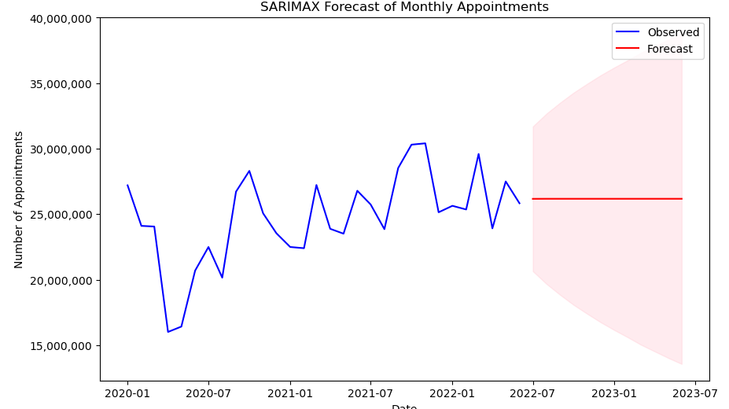

Resource Utilisation Analysis
The resource utilisation analysis provides insights into how efficiently NHS resources are being used.
STL Decomposition and SARIMAX Forecasting:
STL Decomposition: The decomposition revealed clear seasonal peaks, typically during the winter months, indicating a consistent need for increased resources during high-demand periods.
SARIMAX Forecasting: The model indicated an anticipated increase in appointments during the winter months, highlighting the need for proactive planning to ensure adequate capacity.
Insight: The combination of STL decomposition and SARIMAX forecasting provides valuable insights into seasonal trends and helps plan for future resource needs during periods of high demand.

Slide 7
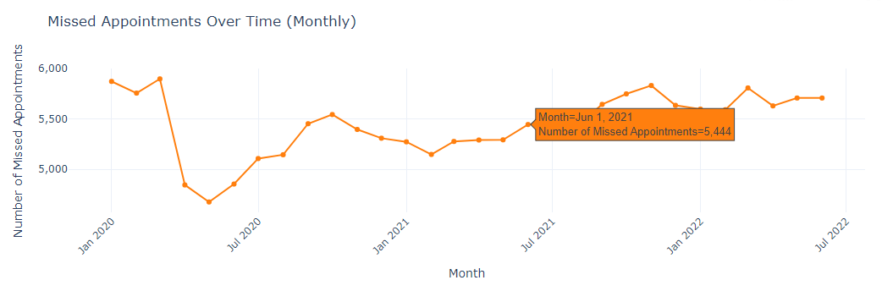

Missed Appointment Analysis
Missed appointments, known as Did Not Attend (DNA), have a significant impact on healthcare efficiency.
Total Missed Appointments
Service Setting Analysis
Healthcare Professional Type Analysis
Insight: Understanding which service settings and healthcare professional types have higher DNA rates helps in designing targeted strategies to reduce missed appointments.

Slide 8
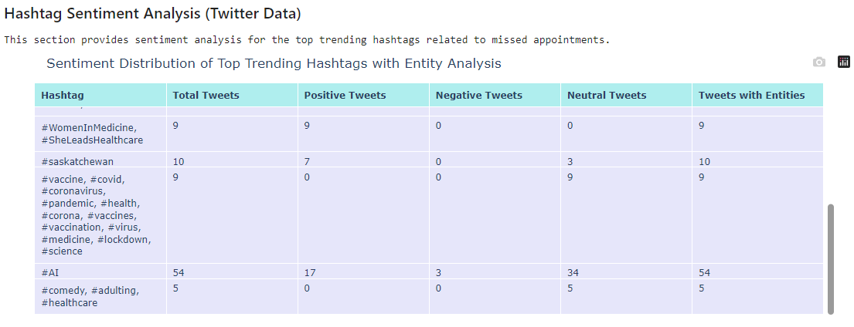

Public Sentiment Analysis
Twitter data was analysed to understand public sentiment towards NHS services.
Sentiment Analysis
Insight: Monitoring public sentiment on social media can help NHS understand patient concerns and address areas of dissatisfaction.

Slide 9
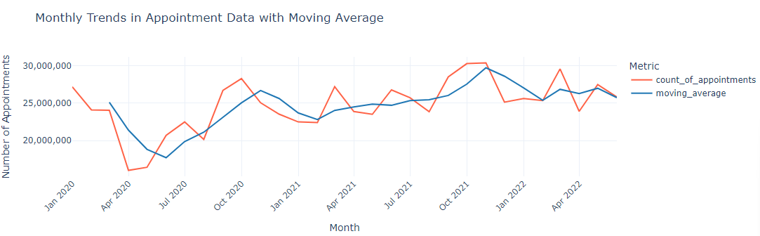
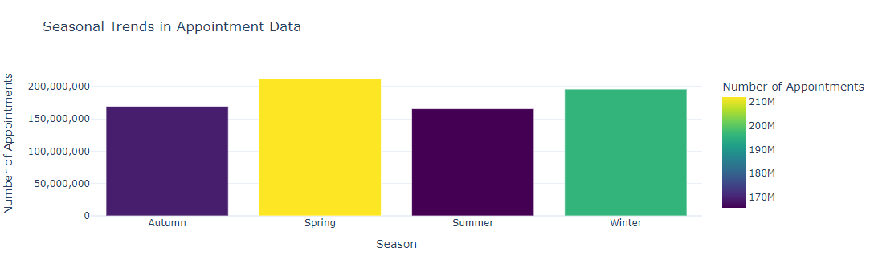
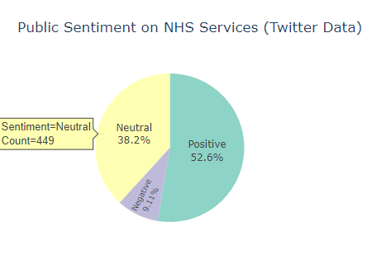

Additional Analysis
Monthly Trends in Appointment Data with Moving Average
Seasonal Trends in Appointment Data
Public Sentiment on NHS Services (Twitter Data)

Slide 10

Summary and Recommendations
This comprehensive data analysis provides actionable insights that can be used to optimise healthcare services, improve appointment attendance, and enhance public perception of NHS services. The combination of advanced statistical techniques, interactive visualisations, predictive modeling, and NLP ensures that the conclusions drawn are both reliable and insightful, providing a robust foundation for strategic decision-making.
Recommendations:
Implement Dynamic Capacity Planning
Targeted Outreach to Reduce Missed Appointments
Seasonal Resource Adjustment
Enhance Public Engagement

